Slide 3
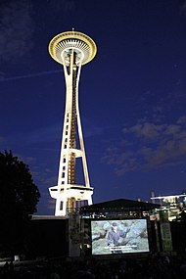
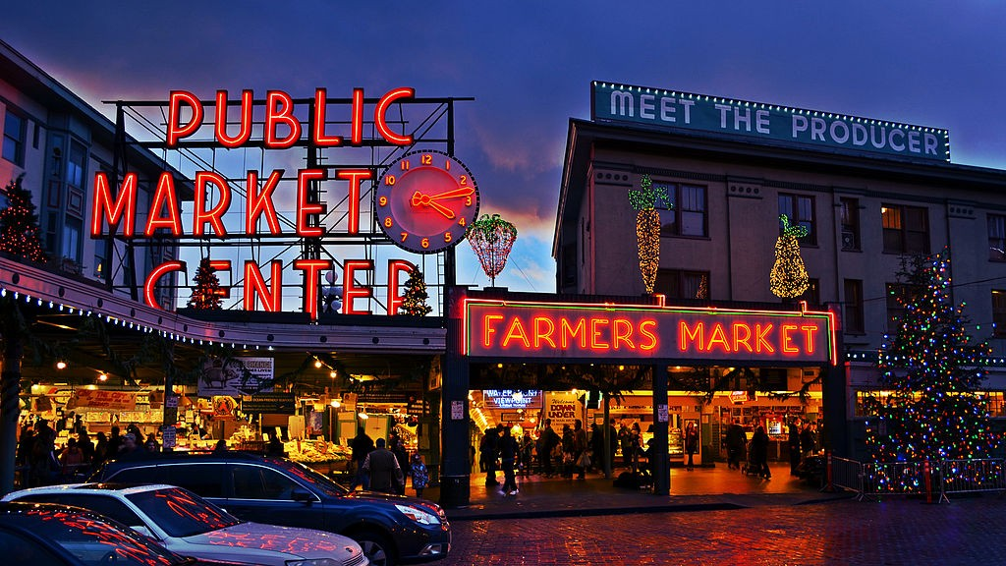
UW Campus
Located in the heart of Seattle
Busses and light rail stations
Large variety of food places within walking distance
Seattle is a destination City
Space Needle & Seattle Center
Pike Place Market
RoboMaster goes to Gasworks Park
Seattle summer weather
Not humid
Generally not too hot
Pointy boi
Fish Yeeting

Slide 4
Housing
UW Housing & Food Services (HFS)
Able to provide conference housing for many people at a fixed rate (~$60/person/day)
Staying in dorms can help teams build community outside the venue
Includes some food budget which can be used to cater lunch
This choice is entirely up to visiting teams, but the option exists as a baseline.

Slide 6
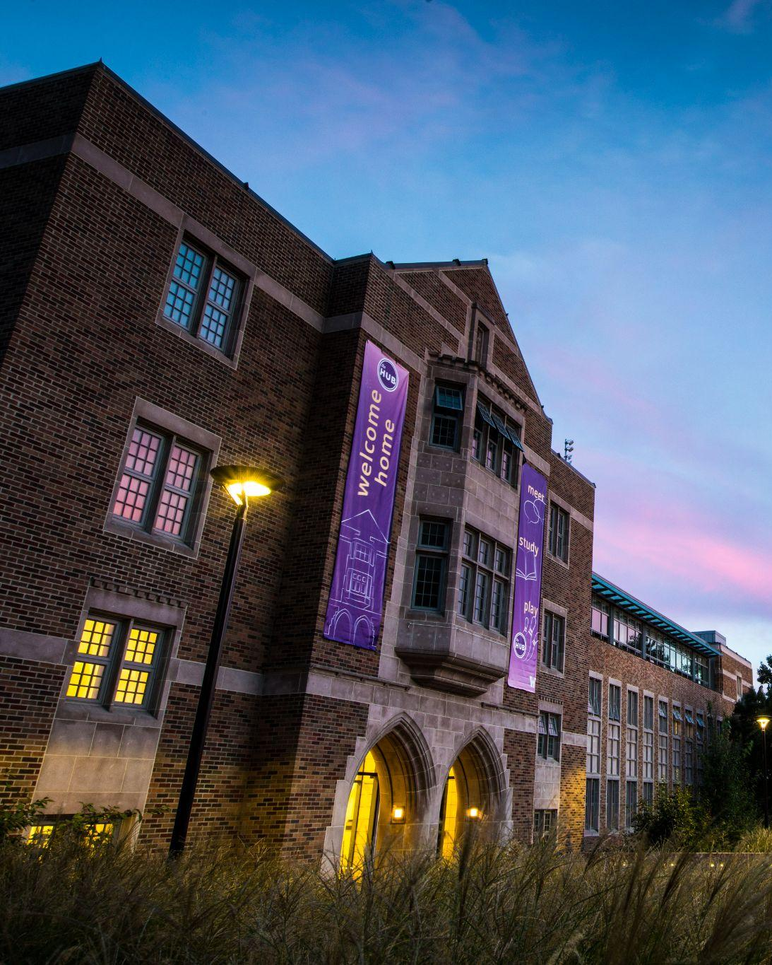
The HUB
Large, low-cost event spaces in the middle of UW campus.
Is a ballroom: need to design and construct arena ceiling
Built-in broadcast studio, gaming center, and 👀bowling lanes 👀
Downside: not open on weekends (without paying more)

Slide 7
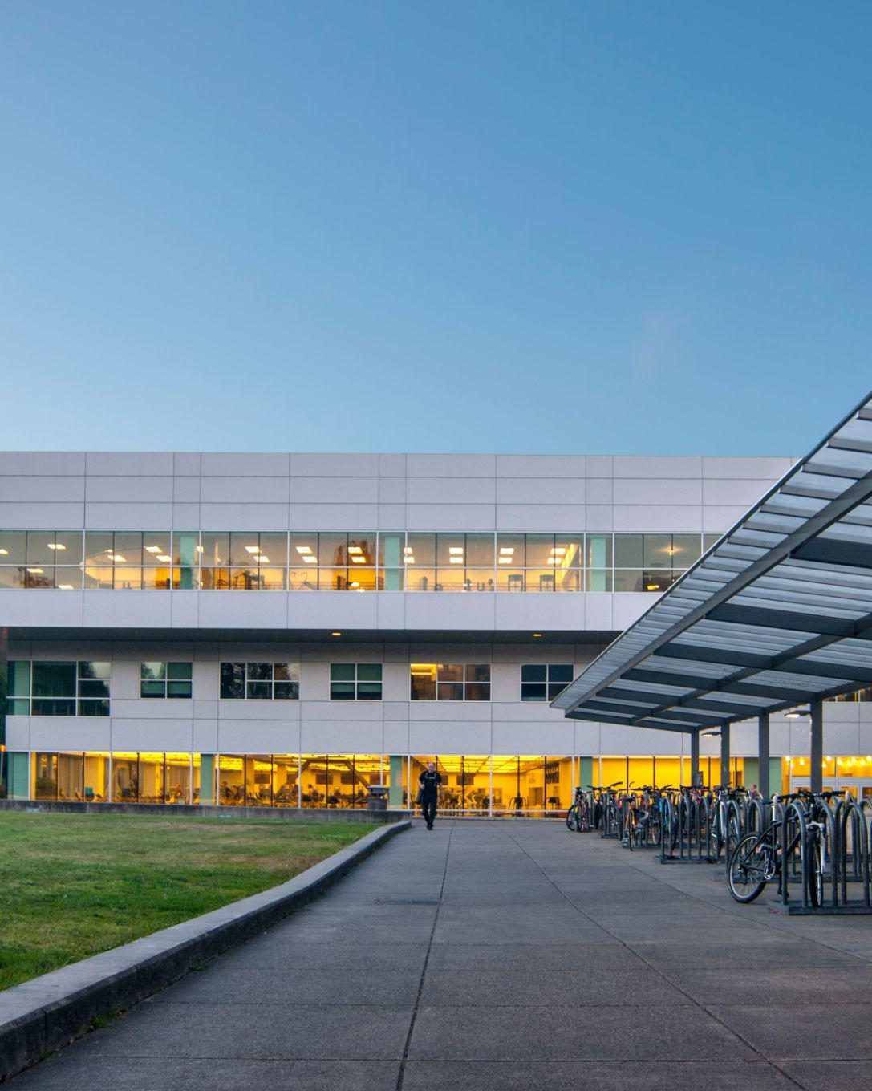
UW IMA
Very low cost for students
Gyms, with bleachers!
Close to a huge parking lot
Walkable, on campus, close to train station
Designed for sports competitions (no roof required)

Slide 9
Outreach and Community
FIRST Robotics and VEX
Introduce middle/high school students to RoboMaster
Show upcoming HS grads what college-level robotics looks like
Seattle tech industries
Big Tech: Microsoft, Amazon
Aerospace: Boeing, Blue Origin, SpaceX
Open event, brings local families with small children to experience STEM
Use of RM S1s is dependent on our sponsors’ requests

Slide 10
Advertising and Sponsorships
FIRSTWA
Social media through ARUW
Flyers on campus
Twitch Stream building up to the Summer Break
Potential sponsorship money from companies on the right (and more!)

Slide 11
Volunteers and Equipment
FirstWA to leverage their volunteer network to help us
We can likely net around 30-40 volunteers through this
ARUW’s alumni network (Ex: Austin)
UW HUB has a built-in broadcast studio
UW STLP/HUB has computers for use
UW owns referee systems, which can be used to accelerate volunteer training
We need to be more prepared in terms of training, training materials, a timeline for volunteer training, etc.

Slide 12
Budget
Looking to raise ~$30,000 for total costs
HUB: ~$15,000
IMA: <$5,000
Have participating teams pay for 3v3 entry:
Prize pool: Top 3 get a prize
$200-$500 to enter

Slide 13
Pizza Question Time

